Slide 1

Very low exposure simulator
Pralhad Yadwad
Lokesh Pandey
Aditya Phatak
Aryan Kamat
Nitish Pathak
Robin Jenkin | Ujwala Patil | March 2024

Slide 2
Worklet-Very low exposure simulator
Use Monte Carlo to generate very low-exposure images
Bulk processing of input distributions
INPUT: Luminance distribution image
OUTPUT: Low light distribution of photons as image
CONTEXT: Very low light levels can also affect the resolution of images as well as SNR as expected. This is designed to help investigate this phenomenon.

Slide 3
Monte Carlo simulation
Overview:
The Monte Carlo method relies on repeated random sampling to obtain numerical results.
Its underlying concept is to use randomness to solve problems that might be deterministic in principle.
They are particularly useful for problems that are otherwise intractable or too complex to analyze mathematically.
Problem Classes Addressed by Monte Carlo Methods:
Optimization: These methods help find optimal solutions by exploring different possibilities.
Numerical Integration: Monte Carlo techniques can approximate definite integrals by random sampling.
Generating Draws from Probability Distributions: They are used to simulate random variables from specific distributions.
Modeling Uncertainty: Monte Carlo methods handle phenomena with significant uncertainty in inputs, such as assessing the risk of a nuclear power plant failure¹.

Slide 4
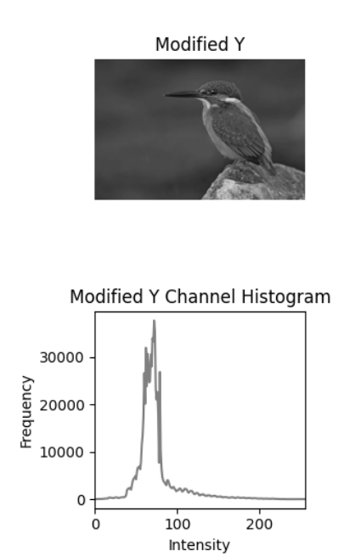
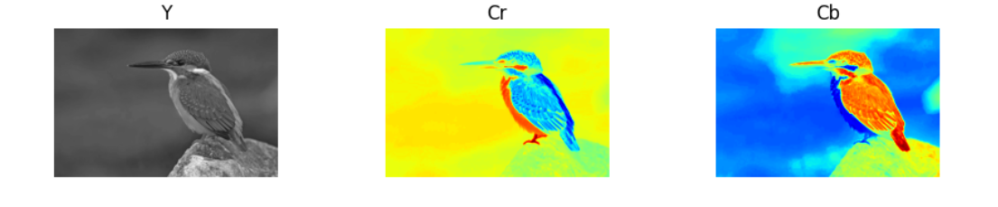
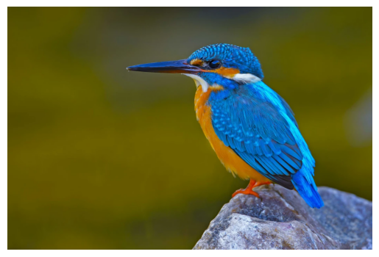
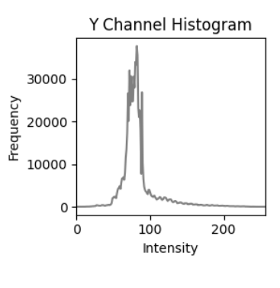
Our Understanding and related work

Slide 5
Our Questions
Is the given is a graphics rendering worklet or a physics oriented worklet
Reference materials

Slide 6
Thank you

